Slide 1
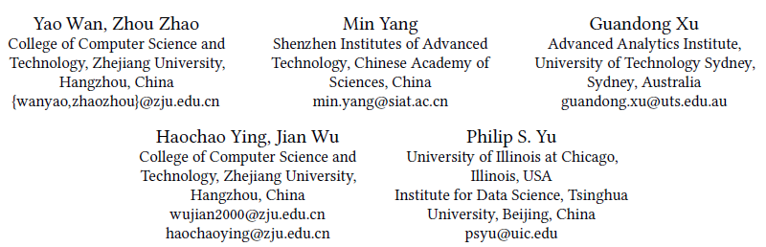
Improving Automatic Source Code Summarization via Deep Reinforcement Learning
ASE 2018

Slide 2
Outline
Issues on code summarization
Address these mentioned issues
Experiments

Slide 3
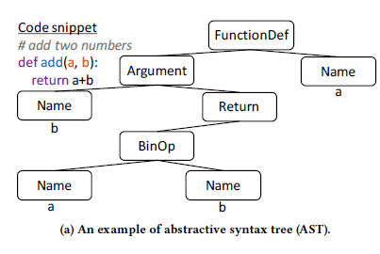
Issues on code summarization
The code sequential and structural information is not fully utilized on feature representation

Slide 4
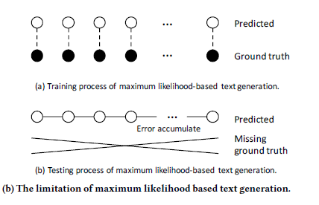
Issues on code summarization
exposure bias

Slide 5
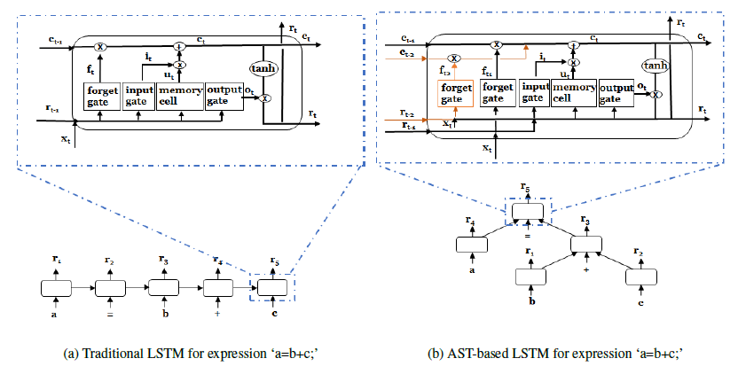
Hybrid code representation
We apply an LSTM to represent the lexical level of code, and an AST-based LSTM to represent the syntactic level of code.

Slide 6
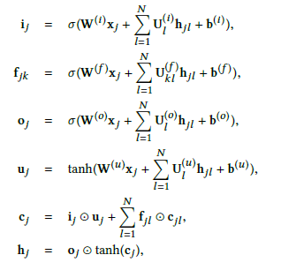
Hybrid code representation
N-ary Tree-LSTMs*
Notice that the number of children N varies for different nodes of different ASTs, which may cause problem in parameter-sharing.
Transform the generated ASTs to binary trees:
split nodes with more than 2 children, and generate a new right child together with the old left child as its children, and then put all children except the leftmost as the children of this new node. Repeat this operation in a top-down way until only nodes with 0, 1, 2 children left;
combine nodes with 1 child with its child
*Improved semantic representations from tree-structured long short-term memory networks
Notes:
子节点个数不超过N，且子节点左右有序

Slide 7
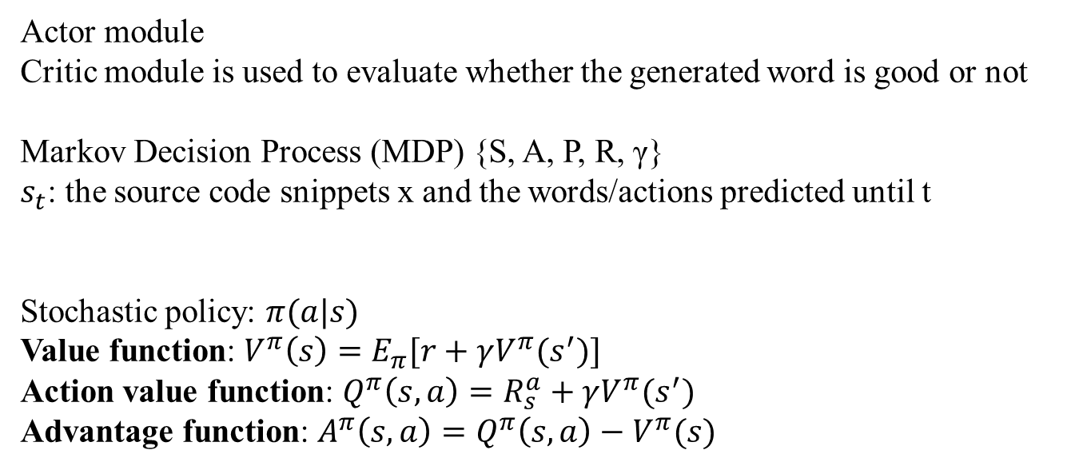
Actor-Critic Algorithm
Actor module
Critic module is used to evaluate whether the generated word is good or not
Markov Decision Process (MDP) {S, A, P, R, γ}
$s_{t}$: the source code snippets x and the words/actions predicted until t
Stochastic policy: $π(a|s)$
Value function: $V^{π}\left(s\right)=E_{π}[r+γV^{π}(s^{′})]$
Action value function: $Q^{π}\left(s,a\right)=R_{s}^{a}+γV^{π}(s^{′})$
Advantage function: $A^{π}\left(s,a\right)=Q^{π}\left(s,a\right)−V^{π}(s)$
Notes:
第二个问题 修改loss
当前状态 s 所能获得的 value，是下一个状态 s‘ 所能获得 value 和 在状态转移过程中所得到 reward 的加和
在状态 s 下，选择动作 a 有多好。如果 action a 比 average 要好，那么，advantage function 就是 positive 的，否则，就是 negative 的

Slide 8
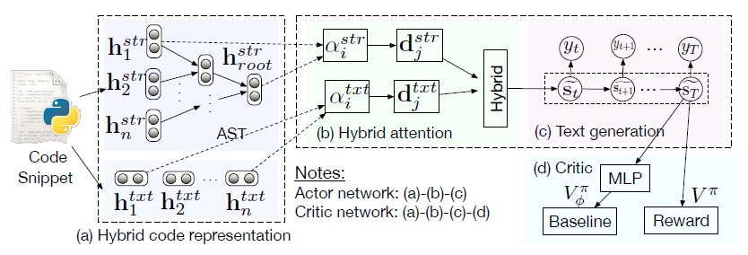
Actor-Critic Network
Notes:
用mlp拟合V

Slide 9

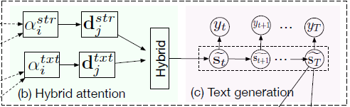




Actor Network

Slide 10
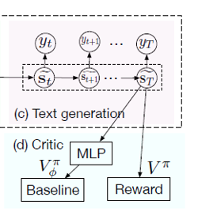



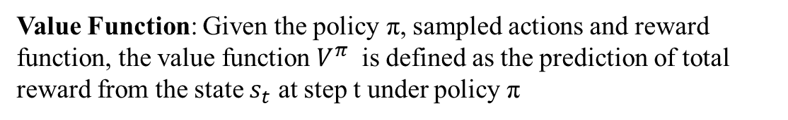
Critic Network
Value Function: Given the policy π, sampled actions and reward function, the value function $V^{π}$ is defined as the prediction of total reward from the state $s_{t}$ at step t under policy π

Slide 11

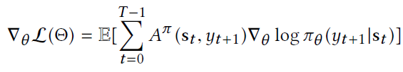



Model training
Loss Function:
Actor network:
Critic network:
$$L\left(Θ\right)=L\left(θ\right)+L(φ)$$
Policy gradient:
For actor network:
For critic network:

Slide 12
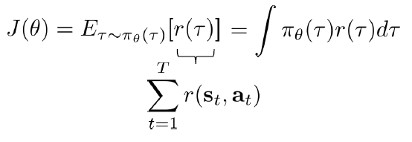
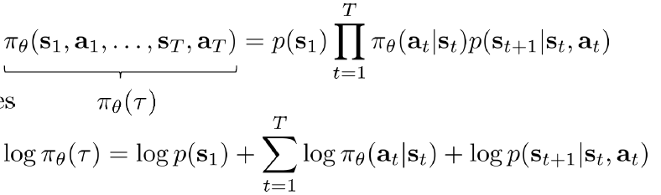
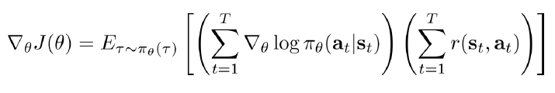
Model training
Notes:
蒙特卡洛采样 效率低，方差大

Slide 13
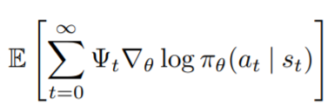
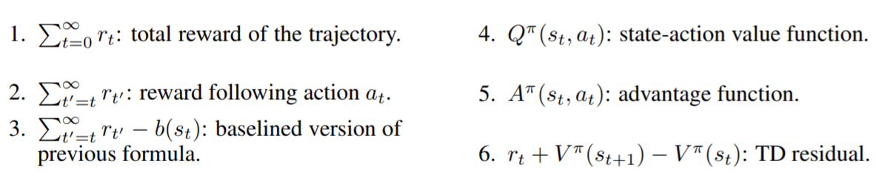
Model training
*Policy Gradient Methods for Reinforcement Learning with Function Approximation
*High-Dimensional Continuous Control Using Generalized Advantage Estimation

Slide 14
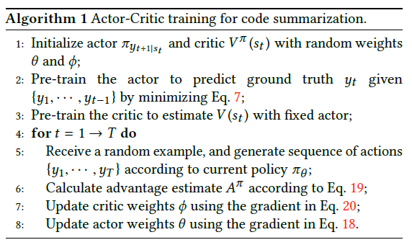


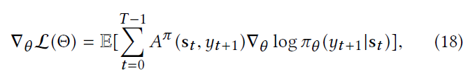
Model training
We start with pretraining an actor network using standard supervised learning with cross entropy loss, and pretraining a critic network with mean square loss
Notes:
预训练 Alphago 采样

Slide 15
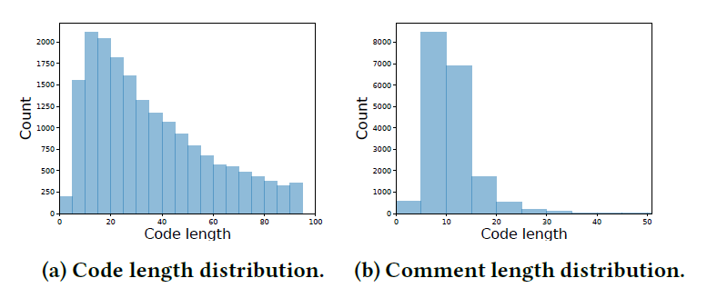
Experiments
Dataset
A parallel corpus of Python functions and documentation strings for automated code documentation and code generation
108,726 code-comment pairs

Slide 16
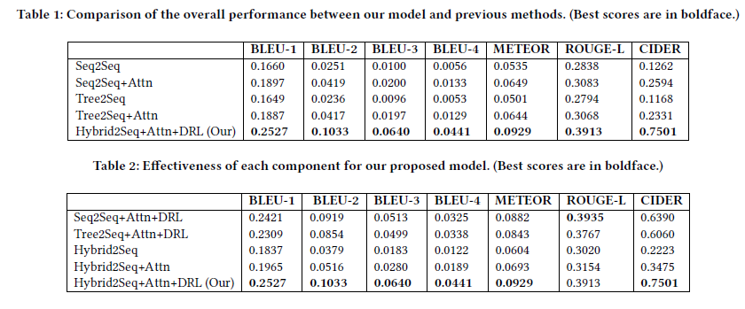
Experiments

Slide 17
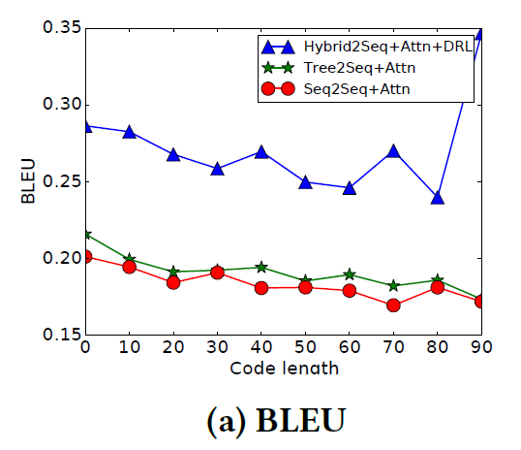
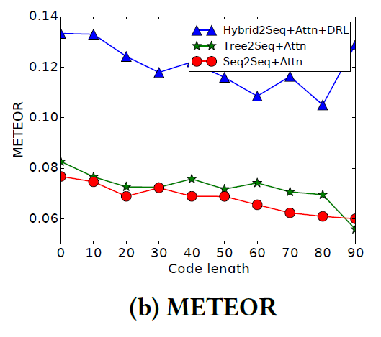
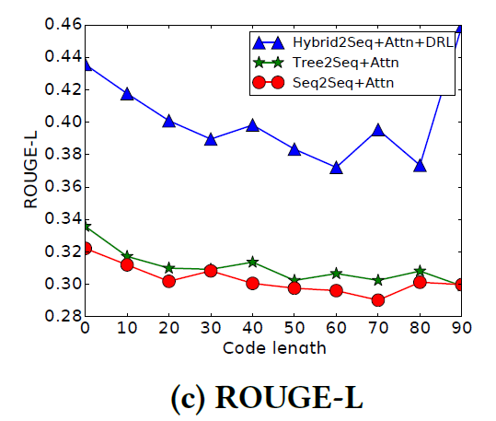
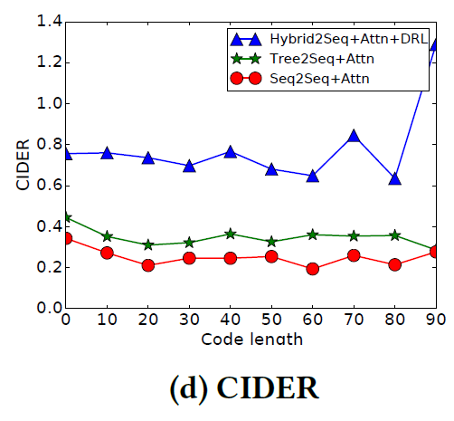
Experiments

Slide 18
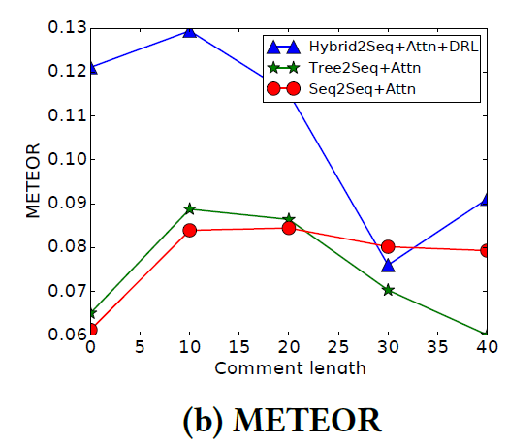
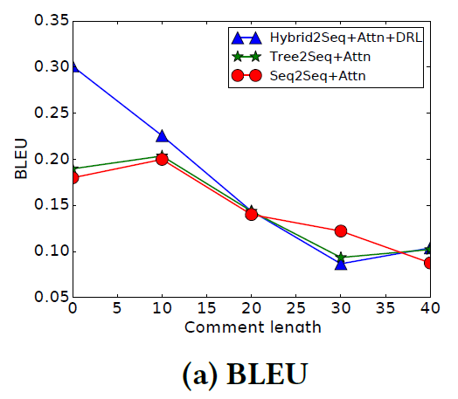
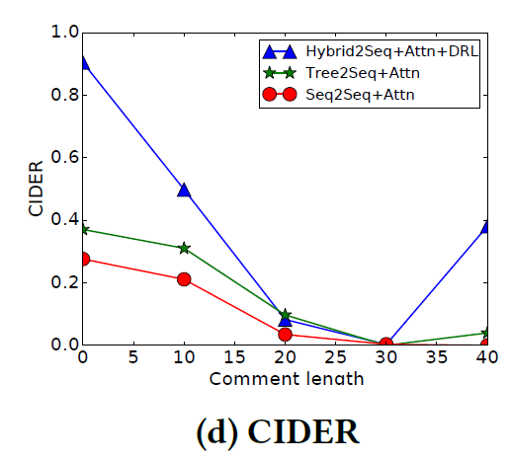
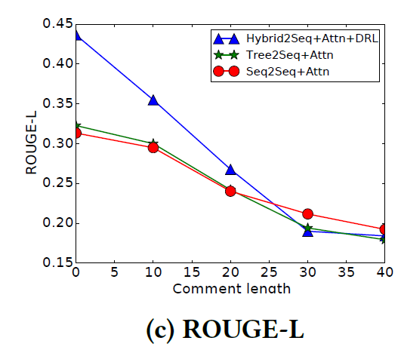
Experiments

